Slide 1

ADU Study Committee
May 17, 2022
Demographic and Housing Considerations

Slide 2
Agenda
Discussion Items
Call to Order
Demographic and Housing Considerations
Community Planning Department
Design Considerations
Historic Districts Commission
Upcoming Meeting Schedule and Agenda Topics
June 7, 2022
Hingham Affordable Housing Trust and the Unity Council
Adjournment

Slide 3
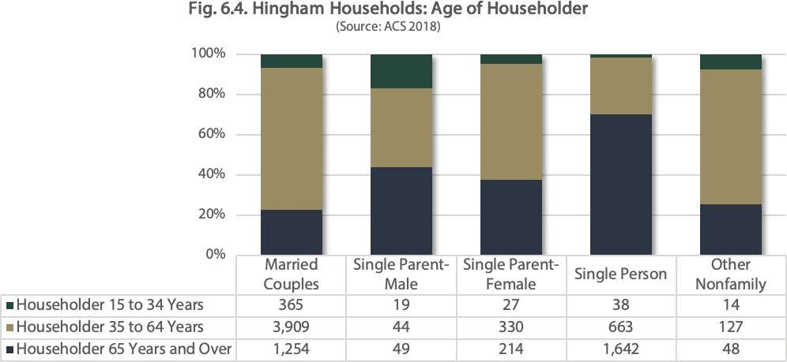
Population Characteristics, Household Age and Size
Aging Population
Projected Decline in Children and Middle Age
Growth in Smaller Households
ADU Study Committee, May 17, 2022
Notes:
There have been major increases in older residents, likely related in part to both the Baby Boomer generation and age-restricted development such as Linden Ponds. The trend is expected to continue. The University of Massachusetts Donahue Institute estimates that resident over 75 years of age will increase from 12% today to 24% in 2035 (see pie chart in upper left for visual). The proportion of children under 18 are conversely expected to decrease slightly from 26% today to 23%.
I would also highlight the decreasing size of households, including those living alone, particularly among those over 65 years of age. In the table at the bottom right, you can again see a visual of the share of that household cohort that consists of a single-person.

Slide 4
Population Characteristics, Disability
Comparison Estimates of Population with Disabilities (2018)
 | Hingham |  |  | Massachusetts
 | No Disability | Disability | Percent Disability | No Disability | Disability | Percent Disability
Under 5 | 1,371 | 0 | 0.0% | 360,002 | 2,679 | 0.7%
5 To 17 | 4,723 | 68 | 1.4% | 956,270 | 57,869 | 5.7%
18 To 34 | 2,474 | 119 | 4.6% | 1,552,314 | 97,971 | 5.9%
35 To 64 | 9,036 | 481 | 5.1% | 2,395,878 | 291,411 | 10.8%
65 To 74 | 1,968 | 248 | 11.2% | 475,505 | 128,921 | 21.3%
75 Plus | 1,656 | 905 | 35.3% | 230,615 | 206,580 | 47.3%
Total | 21,228 | 1,821 | 7.9% | 5,970,584 | 785,431 | 11.6%
Source: Table 6.1 of the Draft Master Plan Original Source: ACS 2018, B18101. Note: “disability” as defined by the Americans with Disabilities Act (ADA) is not the same as “disability” in the Individuals with Disabilities Education Act (IDEA) or Massachusetts Special Education Law, Chapter 71B. As a result, the 1.4 percent of children 5-17 with a disability in Table 4.1 cannot be compared with the 14+ percent students with disabilities in the Hingham Public Schools.
ADU Study Committee, May 17, 2022
Notes:
Related in part to age, but certainly not entirely, almost 8% of Hingham residents have a disability. The largest share of these residents is 75 or older.

Slide 5
Housing Characteristics
Cost Burdened Households
30% or 2,493 households were spending too much for their housing (spending more than 30% of income on housing costs), including 17% or 1,415 with severe cost burdens (spending more than 50% of income on housing costs)
Two-thirds of those earning at or below 80% AMI were experiencing cost burdens including 1,200 or 51.5% with severe cost burdens.
Identified Needs
Target the needs of the community’s most vulnerable residents.
Continue to promote greater housing diversity.
Invest local resources to support greater numbers of households over time as rentals turnover more regularly.
Provide more appropriately sized units for increasing numbers of smaller households.
Offer opportunities for seniors to downsize in less isolated settings.
ADU Study Committee, May 17, 2022
Notes:
Based on the 2021 Hingham Housing Plan…
Identified needs potentially addressed by expanded opportunity to create ADUs include…

Slide 6
Review of Goals
Identified Goals
ADU Study Committee
ATM 2021
Citizen’s Petition Article 27 submitted to allow detached Accessory Dwelling Units
Hingham Housing Plan
June 2021
Recommended Strategy to Better Promote ADUs
Hingham
Master Plan
August 2021
Includes a Policy to “Explore the possibility of allowing detached accessory dwelling units in some or all of the areas where accessory dwelling units are now allowed for family members, but not for rental.”
Town Meeting created this Study Committee to make a report to the Planning Board in Oct 2022
Options include detached ADUs and elimination of familial restrictions from current By-Law
Notes:
We hope to hear from the Housing Trust and other interested organizations at upcoming meetings, but members might begin to consider identified needs and stated goals of our existing plans could be met in part through an expanded ADU By-Law. The currently stated purposes include:
Provide accessory dwelling units without adding to the number of buildings in the Town or substantially altering the appearance of the dwelling and for the purpose of enabling owners of single-family dwellings to share space and the burdens of homeownership with family members (as defined in this Section V-K) while also protecting the stability, property values and residential character of the surrounding neighborhood.
b. Provide housing units for family members with diverse housing needs including, without limitation, family members with mental and physical disabilities.
c. Enable the Town to monitor accessary dwelling unit construction for code compliance.

