Slide 1
AGENDA
CPA Final Application Review
Administrative Items
Approval of Minutes
Items Not Anticipated Within 48 Hours of the Meeting

Slide 2
PROCESS
September 9th - Preliminary applications due
September 17th - CPC reviewed the preliminary applications for eligibility
October 7th - Final applications were due on October 7th
October 21st – Final Application Review
October 25th – Site Visits
November 4th and 5th – Project Hearings/Proponent Presentations
December 10th – CPC Final Review of Pending Applications
January 7th - Final Project Presentations from proponents
January 14th - CPC will vote our final recommendations to Annual Town Meeting
The Select Board and the Advisory Committee - hold hearings and make recommendations
April 26th - Town Meeting voters will make the final decision

Slide 3
Project: Basketball Court Restoration at Plymouth River School
Applicant: Hingham Recreation
Request: $343,500 ---- reduced from preliminary $350,500
Total Cost: $343,500
Category: Recreation; Create/Rehabilitation
Description:
Re-construct the court surface and make necessary roof structure repairs.

Slide 4
Project: GAR Hall Elevator Replacement
Applicant: Town of Hingham, Veterans Services
Request: $160,000 --------- preliminary $151,500
Total Cost: $160,000
Category: Historic; Rehabilitation
Description:
GAR Hall elevator breaks down requiring regular repair. Request is to replace the elevator for ADA compliance.

Slide 5
Project: “Pro Patria et Gloria”
War Memorial Restoration
Applicant: Hingham Historical Commission
Request: $30,300 ------------------ preliminary app $22,500
Total Cost: $30,300
Category: Historic, Restoration
Restoration will include:
Removal of degraded coating wax,
Spot patina in areas scratched, corroded and abraded to match colorations of adjacent surface
Recoat with Incralac using HVLP spray
Application of Butchers wax after coating has cured

Slide 6
Project: Community Center
Preservation and Restoration Project
Applicant: Hingham Community Center/John Thaxter House
Request: $337,317 ------------- preliminary app $307,000
Total Cost: $357,317
Category: Historic; Preserve/Rehabilitation
Description:
To ensure the building's continued use and historical integrity, we are prioritizing a series of capital improvement projects. These efforts are designed to maintain the buildings safety, functionality and historical character, enabling the Hingham Community Center to provide diverse and vibrant programming as well as offering event space for years to come. Proposed projects are listed in order of priority on attachment.

Slide 7
Project: Community Center
Preservation and Restoration Project
Renovation of Two Second-Floor Restrooms
Restoration of the Central Street-Facing Exterior
Restoration of the Central Street-Facing Exterior
Structural Repairs and Historical Restoration of the Front and Side Portico Entrances
Update of Two Lower-Level Restrooms
Removal and Replacement of Rear Vinyl Siding with Cedar Shingles
Repointing of Five Chimneys and Fireplaces
Installation of Acoustical Panels in the Ballroom
Interior Painting

Slide 8
Project: Thaxter Park -Roof Replacement
Applicant: Hingham Housing Authority
Request: $299,572.00
Total Cost: $599,144.00
Category: Housing; Preservation
Description:
Remove and Install new 30-year asphalt roof shingle system, gutters and downspouts on 8 buildings. The project cost was determined using the MA State capital planning system and recent roof replacements already conducted by the Housing Authority.
Should grant be awarded applicant will apply for a matching grant from EOHLC (Executive Office of Housing and Livable Communities) under the High Leverage Asset Preservation Program.

Slide 9
Project: HAHT Opportunity Fund
Applicant: Hingham Affordable Housing Trust
Request: $1,000,000
Total Cost: $1,000,000
Category: Housing; Acquire/Create/Preserve/Rehabilitate
Description:
Create up to five new housing units. Acquire and renovate one to two additional condominiums within the next year, creating up to seven new affordable homeownership opportunities over the next two to three years. The Trust also anticipates using funds to make critical capital improvements at the Lincoln School Apartments. Planned upgrades include repointing the historic 1912 building, ADA compliance enhancements, and flooring replacements—all essential to preserving the integrity and livability of this vital affordable housing resource.

Slide 10
Project: 19th Century Steps Restoration at the New North Church
Withdrawn
Applicant: New North Meeting House Corporation
Request: $20,000
Total Cost: $30,000
Description:
With the Lincoln House opening and the Old Ordinary restoration, Fountain Square is emerging as the hub of Hingham’s historic quarter. Request is to rebuild the steps that existed in front of the New North Meeting House in the 19th century restoring the historic streetscape.
Plans include 5-6 Granite steps with wrought iron railings connecting sidewalk on North Street to the new Meeting House Lawn that is part of the redesign of the intersection recently approved by the Select Board.
https://www.hingham-ma.gov/DocumentCenter/View/26142

Slide 11
Project: Lincoln Street, 19th Century Step Restoration
Withdrawn
Applicant: Town of Hingham Department of Public Works
Request: $20,000
Total Cost: $30.000
Description:
Installation of 5-6 granite steps with wrought iron railings connecting the sidewalk on North Street to “elevated” Lincoln Street sidewalk/NNMH lawn.
(other activity in the area: Lincoln House Opening, Old Ordinary restoration, Fountain Square redesign)
https://www.hingham-ma.gov/DocumentCenter/View/26149

Slide 12
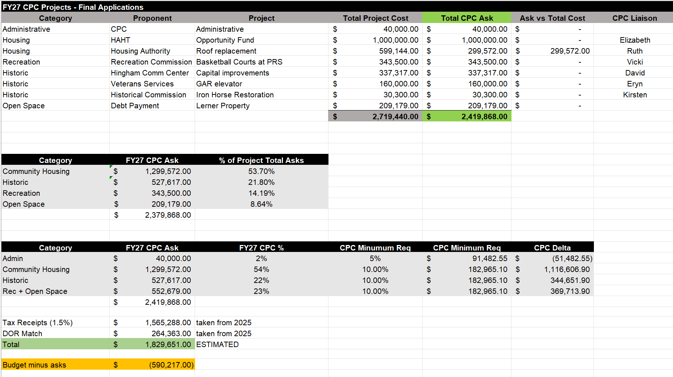
PRELIMINARY BUDGET NUMBERS

Slide 13
Site Visits
Saturday, October 25, 8am
Hingham Rec | 200 High Street | PRS Basketball Courts
Veterans Services | 358 Main Street | GAR Hall elevator
Hingham Community Center | 70 South Street | Capital improvements
Housing Authority | 30 Thaxter Street | Roof replacement
Historical Commission | Hingham Harbor (Boat Ramp) | Iron Horse Restoration

