Slide 1
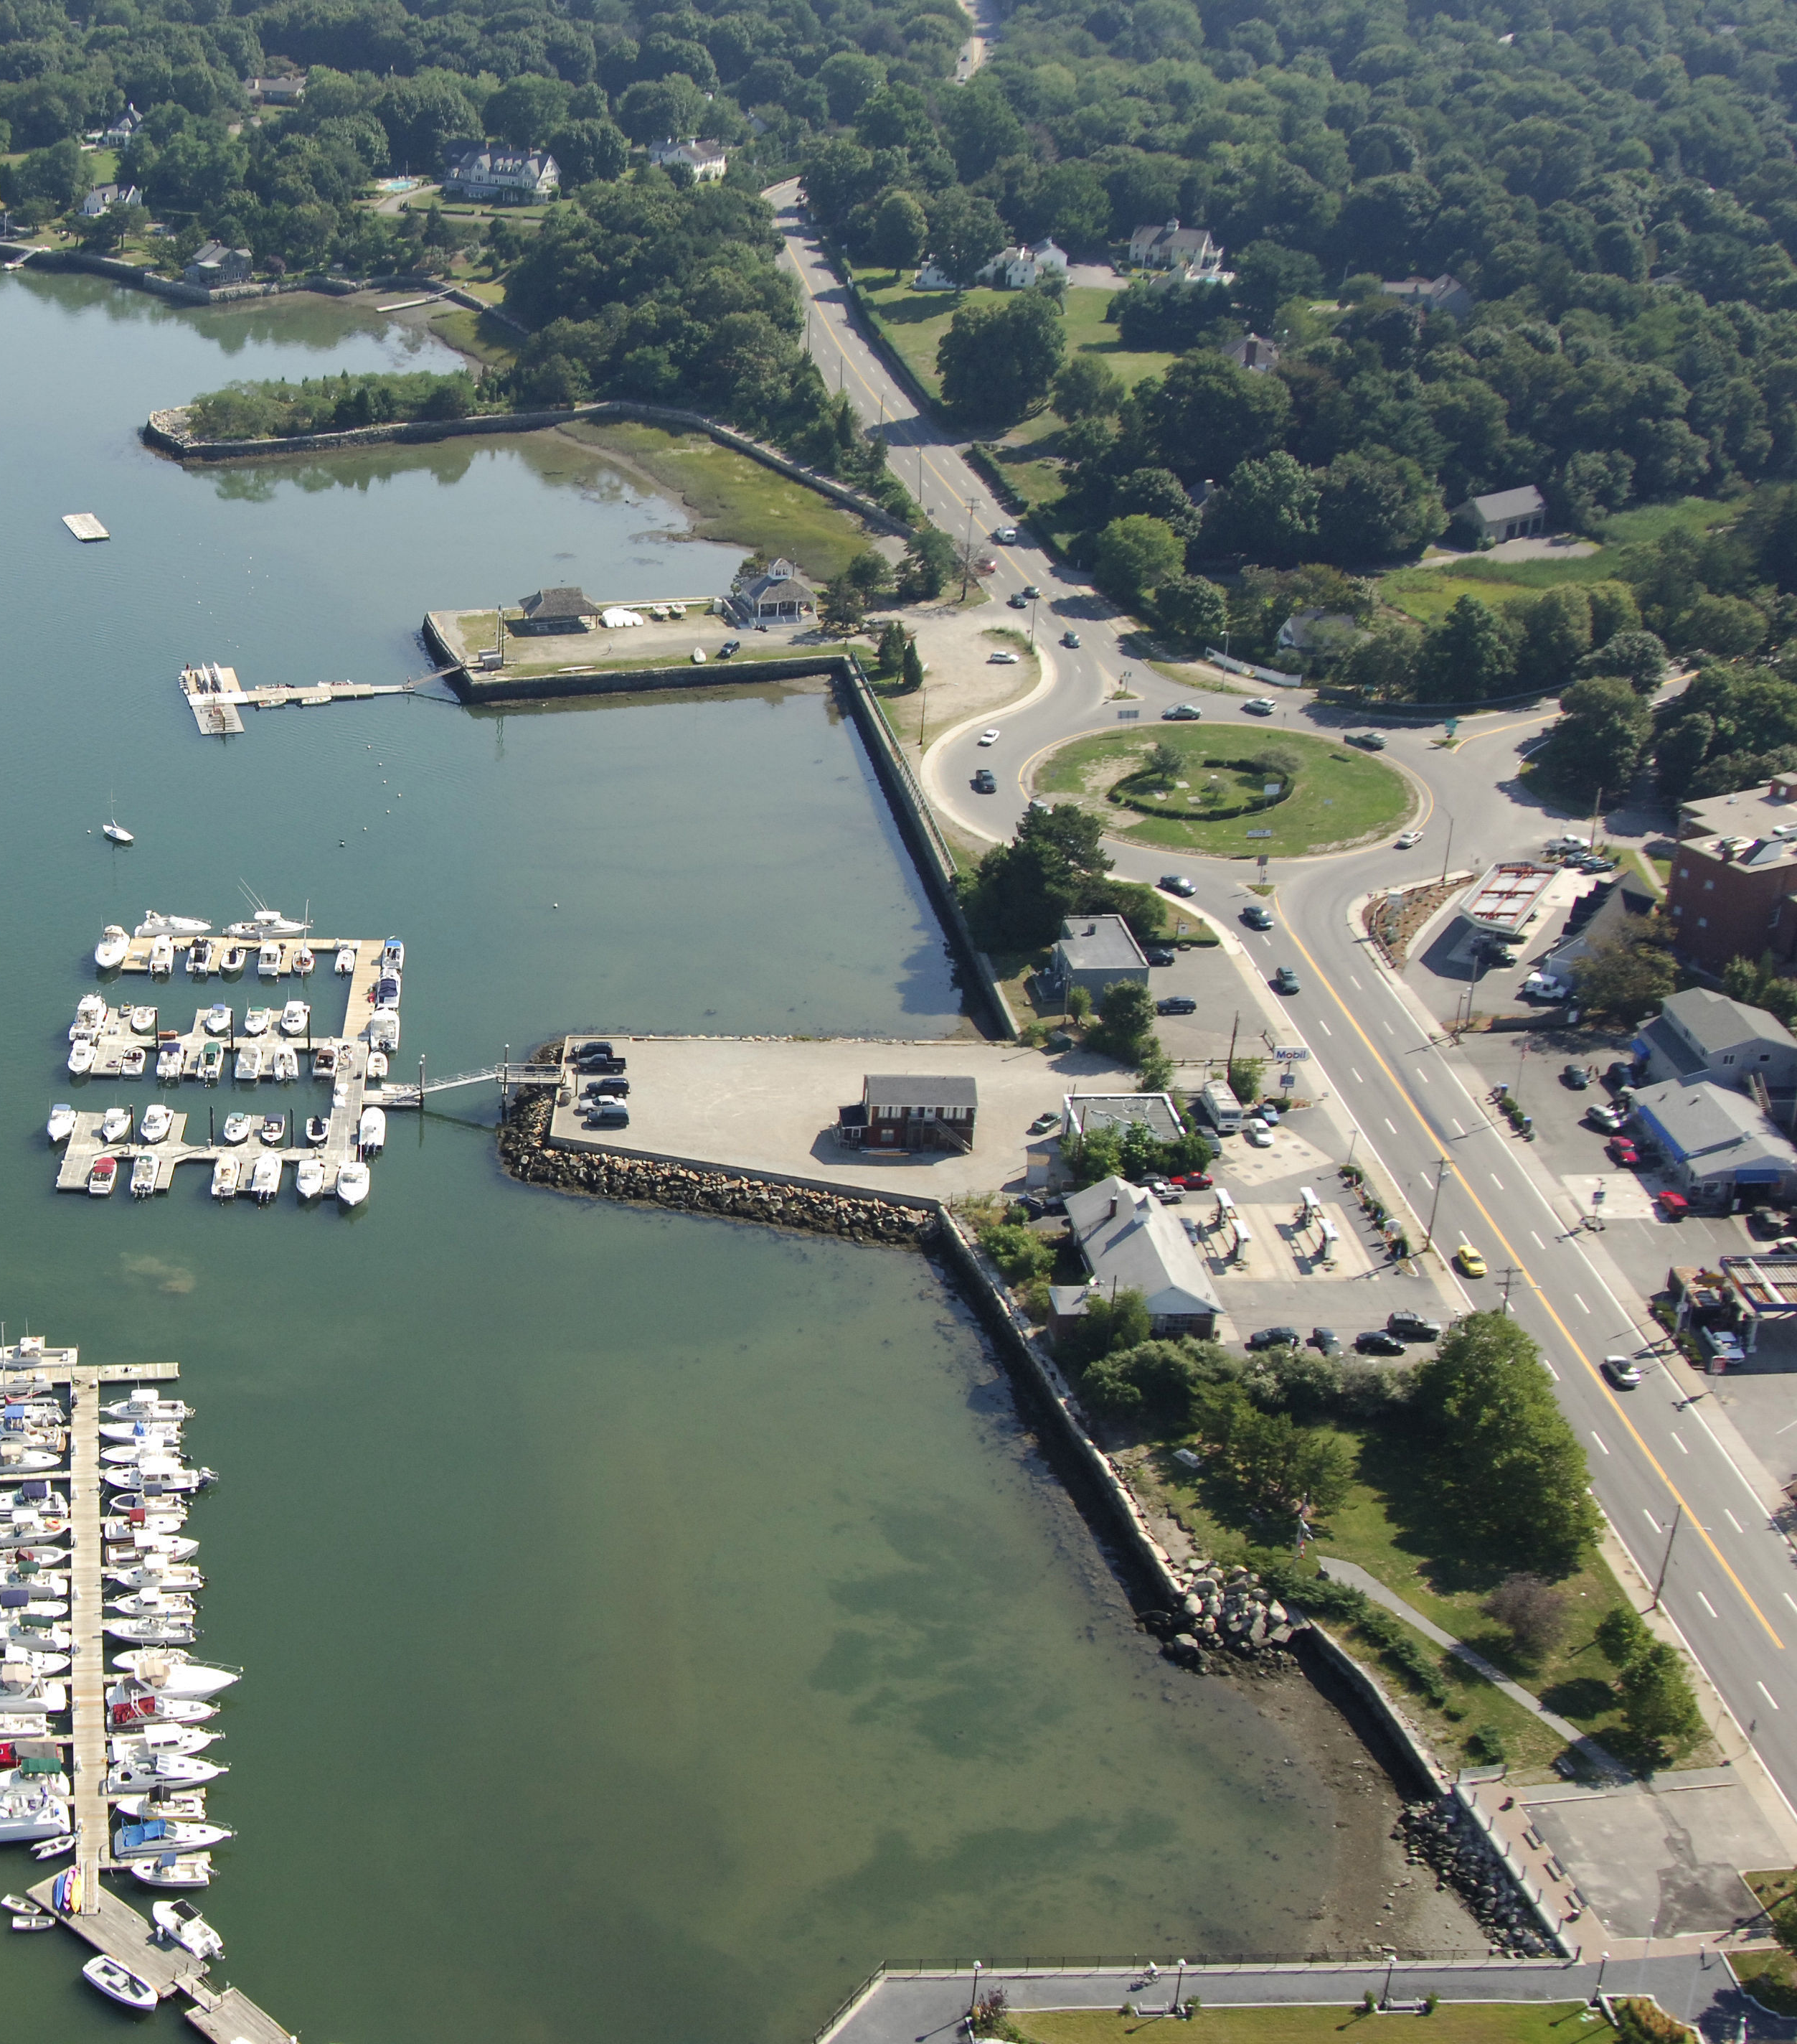
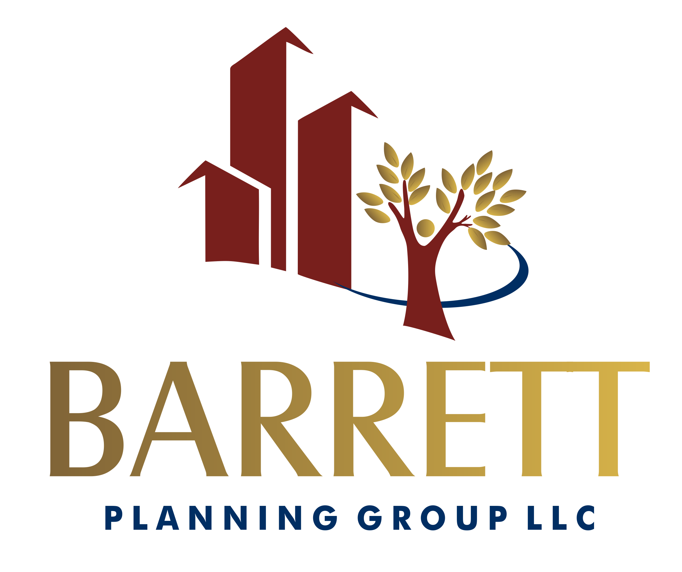




Hingham Comprehensive Master Plan
January 10, 2019
Martha Lyon Landscape Architecture LLC

Slide 2




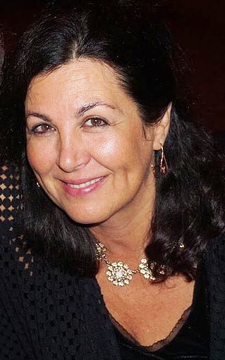

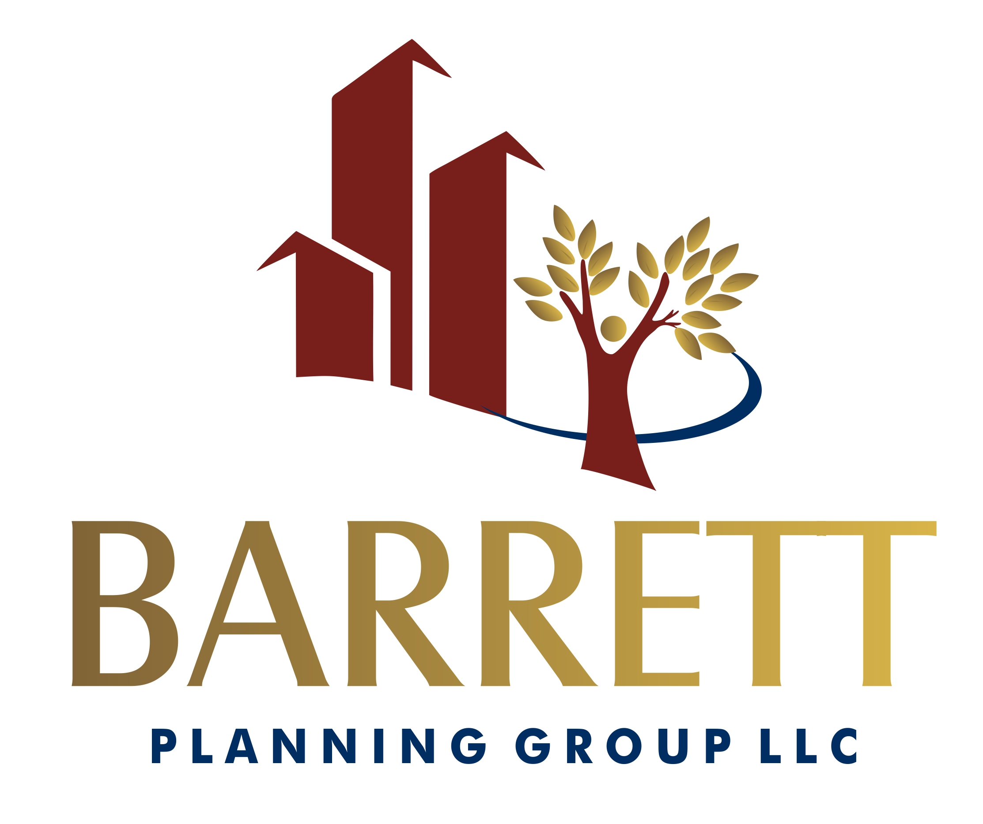
Our Team
Martha Lyon Landscape Architecture LLC

Slide 3

What is a Master Plan?
A master plan is a statement about what a community wants for its future and how to get there.
Future vision
Shared principles
Who is here today?
Who will be here in the future?
Plan for preservation, growth, and change
Implementing actions
Evaluating progress
Making amendments

Slide 4

Basic Steps
Every journey starts with a step …
Visioning
Community baseline
Data analysis
Evaluating opportunities
Selecting a plan
Implementation
Monitoring
Update

Slide 5

Community Baseline (Existing Conditions)
Comprehensive inventory
Careful selection of data sources (try to ‘go local’)
Extensive mapping
Consider the benefit of proprietary data
Listen to the questions people in the community are asking.

Slide 6

Data Analysis
(What does it all mean?)
Identify needs/gaps
Demonstrate trends
Use analyses already complete (regional planning agency, etc.)
Analyze the performance of existing policies and local laws

Slide 7

Opportunities
Connect the dots!
(Connect analysis with existing conditions)
Underperforming commercial areas
Outdated facilities
Undeveloped land
Greenway connections
Potential physical connections
Market opportunities

Slide 8



Selecting a plan
Setting policies
Developing strategies
Resolving tensions
Areas for growth
Areas for preservation
Short and long term
Ask the question: Who benefits?

Slide 9

Implementation
Responsible parties
Timelines
“Next Steps”
Funding
Staffing
Professional assistance?
Know how you’re going to check items off the list!

